Slide 1
VFW License
Decal
Presentation by
Jim Nicklaus, Sr. Vice Commamder
WDM Post 8879
Notes:
Post 8879 is pleased to support the VFW License Decal.
It is important for all VFW Members to promote this unique opportunity.
This presentation will outline the steps to get the decal on your vehicle.

Slide 2
VFW License
Decal
Why
&
How
Notes:
WHY we are so excited about this opportunity?
And let you know HOW to get your decal for your vehicle or vehicles?

Slide 3
Why?
It’s As Simple As ABC
Awareness
Brand Identity
Celebration & Honor
Notes:
WHY, it is a as Simple As ABC: Awareness, Brand Identity, & Celebration.
AWARENESS. This decal is a great way to let the public know that we are Veterans. We recognize all Veterans, both active duty and previous service as well as those who have gone before us.
BRAND IDENTITY. Every organization has a Brand. This decal is our brand. It identifies the VFW.
CELEBRATION & HONOR. Only VFW Members are able to get this decal. Thus we are in an elite group of Veterans in that we have all served our Country overseas in an area of conflict and have been recognized accordingly on our form DD214.

Slide 4
Bonus Value
Recruiting
Tool
Notes:
A Bonus Value of the VFW decal is the recruiting potential it affords. This decal is a conversation starter.
All of our members with the decal have had comments on their decal which opened the door to a VFW conversation.

Slide 5
How
Complete Application
(Download from Website)
Notes:
How do you get the decal on your vehicles?
The process to obtain your decal is as follows:
Download the application.

Slide 6
Notes:
The application can be found on the VFW Iowa website. Notice the license plate on this slide.
Click on this license plate.
Post 8879 has also placed this form on our website in the ‘Resources’ dropdown, and encourages All POSTS to add it to their websites.

Slide 7
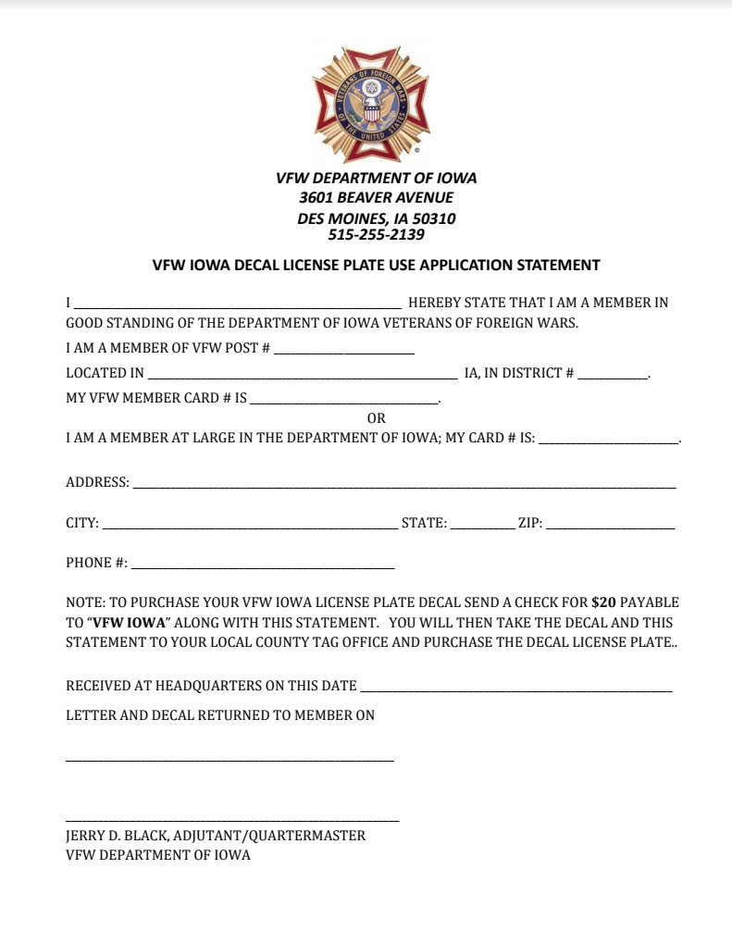
Include Check:
$20 per set of decals
Notes:
By clicking on this license plate - the application form will open. Print this form and complete the questions on it. Mail the completed application to the address on the top of the form.
Or drop it by the State VFW Office in Des Moines. Include $20 per set of decals.
A decal will be placed on both the front and back license plate.
If you would like decals for a second vehicle, indicate so and include $20 for the additional decals.

Slide 8
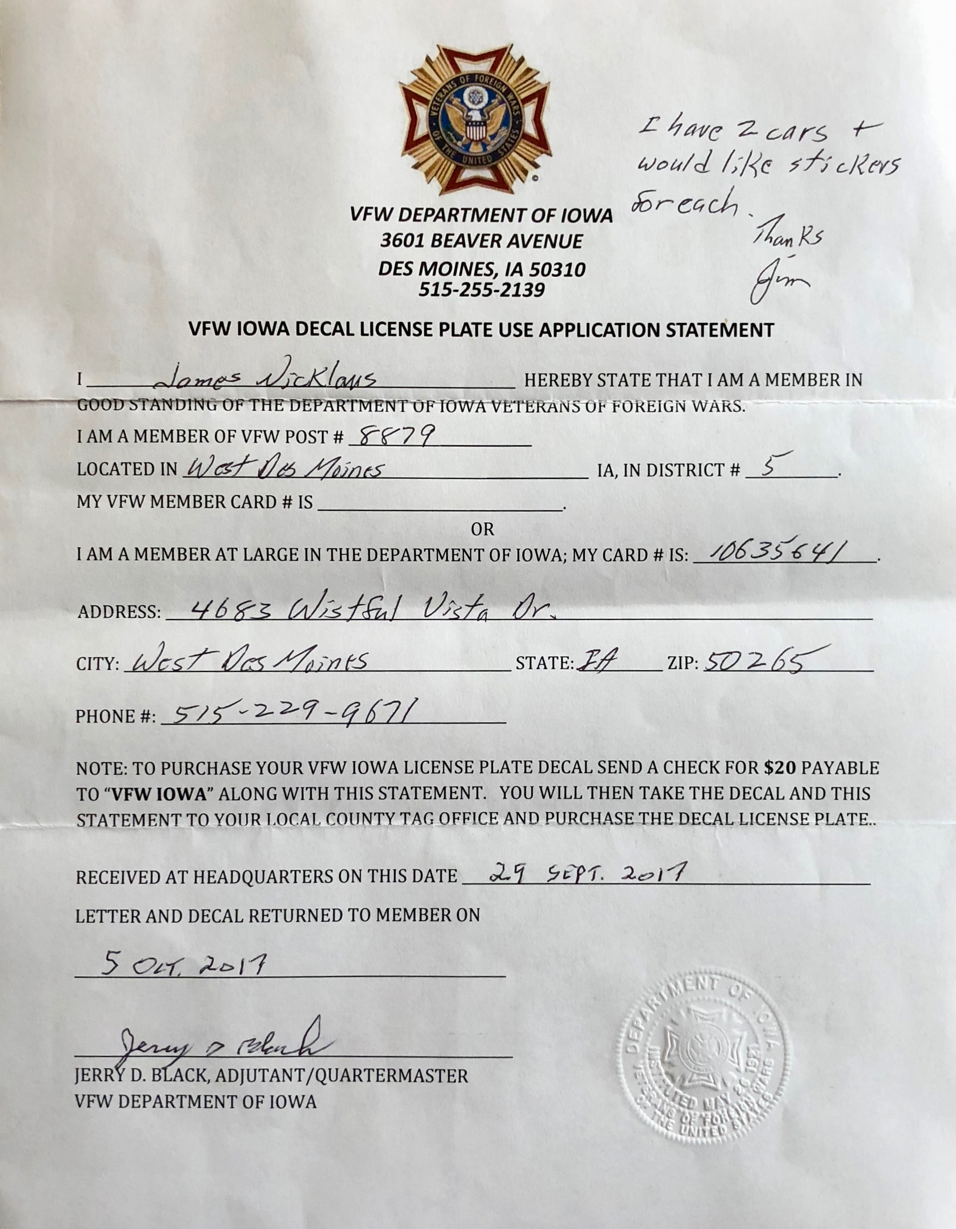
Notes:
You will receive an ‘Authorization Letter’ - which is your application, with a seal in the lower right corner.
Along with this ‘Authorization Letter’ you will receive two decals per vehicle, to be placed on your new 5-character license plates.
This letter will need to be taken to the courthouse to get your new license plates for the decals.

Slide 9
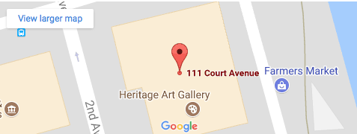
Off To Your Courthouse
Bring:
Authorization Letter from VFW
Current license plates
Current registration
$5.00
Notes:
The Polk County Courthouse is located at 111Court Ave.
There is parking on the South side of the Courthouse.
Vehicle Registration is on the first floor of the building and clearly marked.
Be sure to bring the Authorization Letter from the State VFW, your current license plates, your current registration, and $5.00 processing fee.
If you reside in another county, your courthouse will be able to assist you.

Slide 10
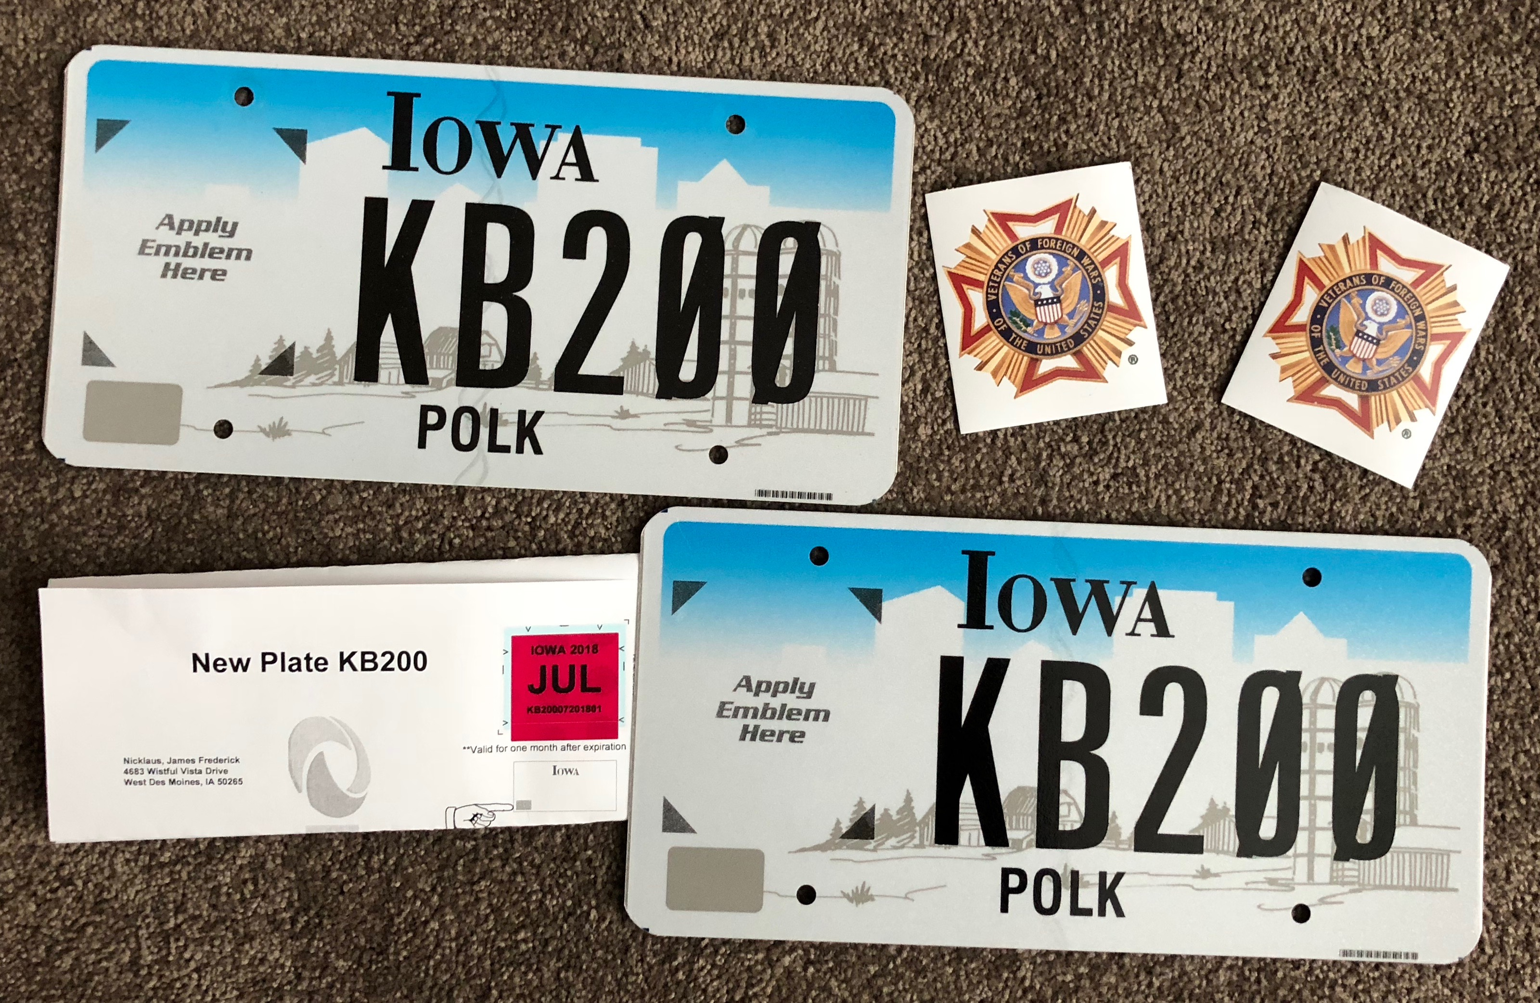
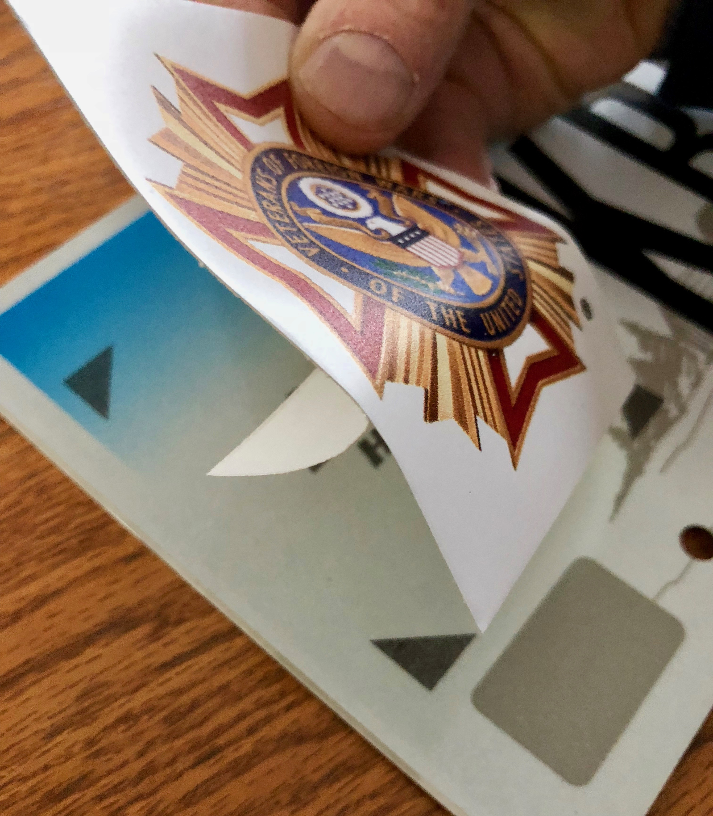
Your New License Plates
Notes:
When you get your new plates, the annual renewal sticker is included.
It is important to note, you are able to swap out your license plates anytime of the year. You DO NOT have to wait for the month of your plate renewal.
Also notice, if you need a handicap sticker on your license plate, the sticker will be a smaller decal to be placed in the lower right corner of the plate.

Slide 11
Carefully peel
the bottom portion
of the Decal from
the backing.
Position
appropriately.
Notes:
Positioning the decals is as follows.
Peal the bottom portion of the decal away from the backing. Carefully position the decal over the two bottom triangles. Then lightly press the decal along the bottom to stick it to the plate. Remove the balance of the backing and let it roll onto the plate.
Another option is to ask the representative at the courthouse if they will apply the decals.

Slide 12
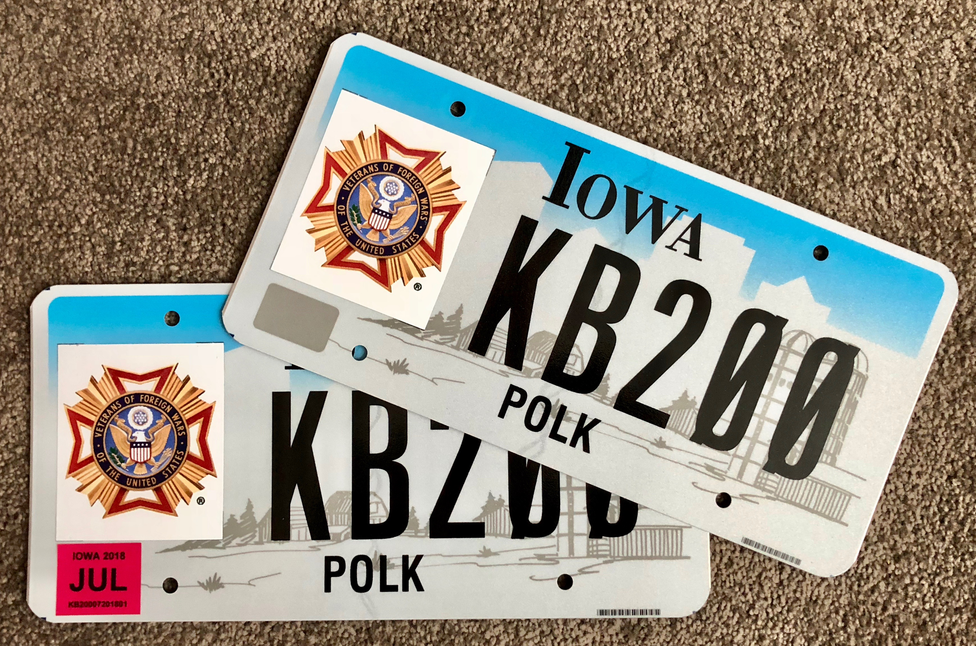
Wa La
Notes:
Wa La - within minutes your plates are ready to be placed on your vehicle and proudly promote your military service, the Armed Forces, and our VFW organization.
We at Post 8879 are pleased to have this opportunity to share our excitement for this decal Logo.

